Slide 1

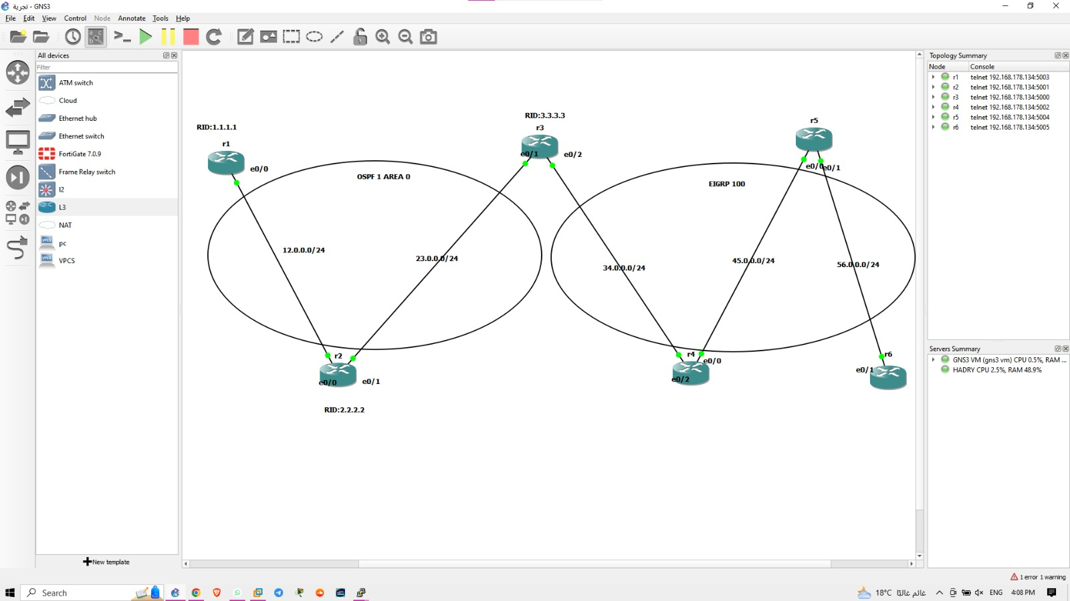
Project Overview Configure and Troubleshoot OSPF and EIGRP
Objective: Successfully configure OSPF and EIGRP on a network, identify and resolve routing protocol issues, and document findings.
Protocols Used: OSPF, EIGRP, Redistribution

Slide 2
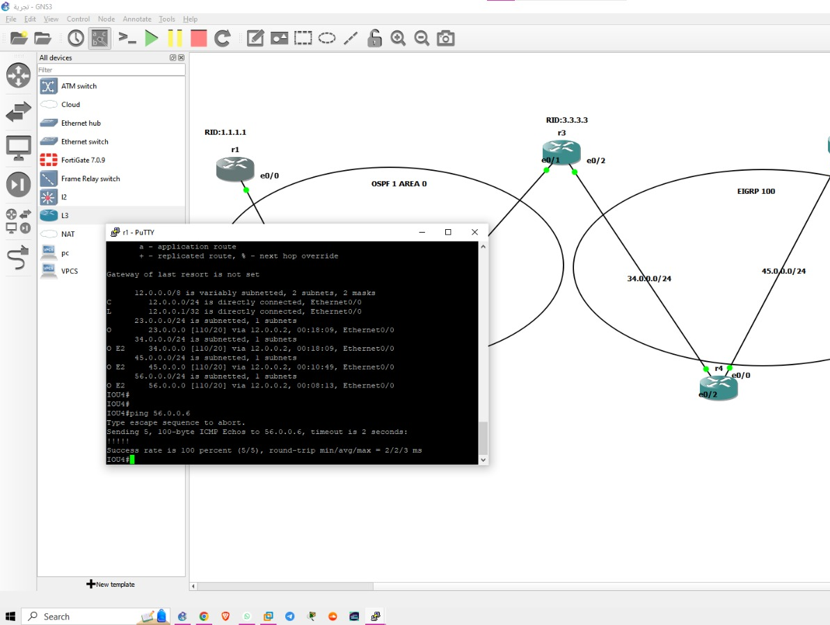
Week 1 – OSPF Configuration
Task: OSPF setup and configuration
Configured router IDs, areas, and networks.
Applied OSPF area types (Area 0 for backbone, other areas for segmentation).
Verified OSPF operations with commands like show ip ospf neighbor and show ip route ospf.
Challenges:
Network convergence timing
Interface priority adjustments for DR/BDR election

Slide 3
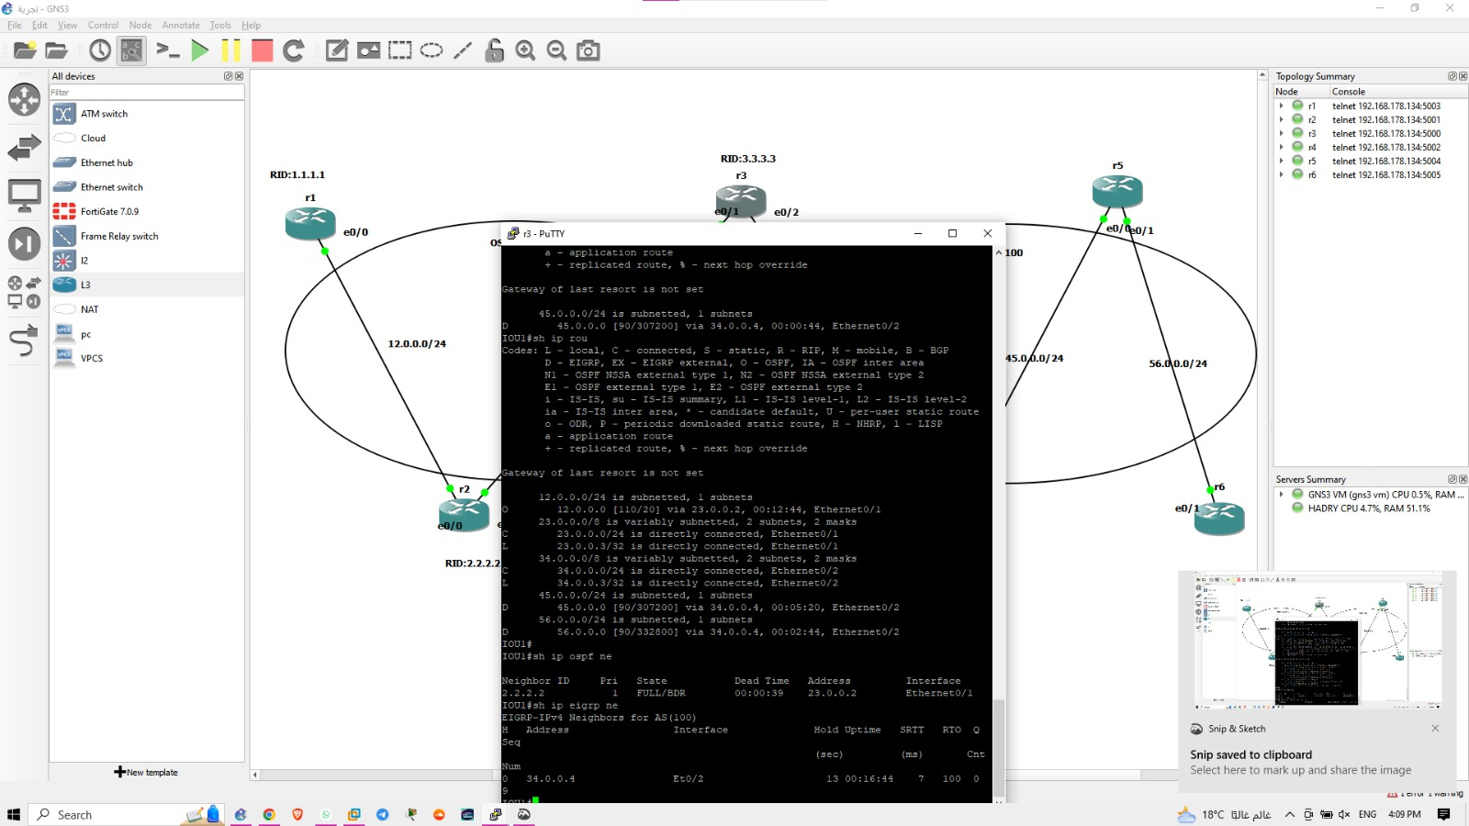
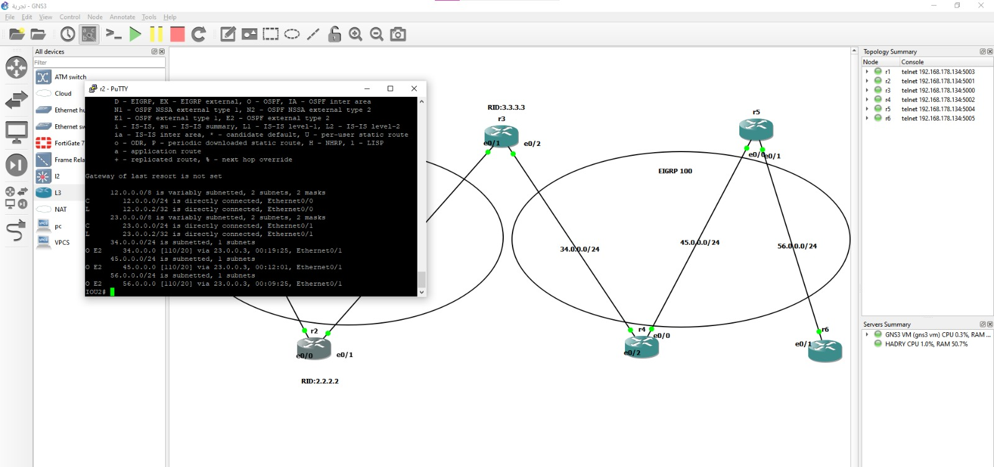
Week 2 – EIGRP Configuration
Task: EIGRP implementation and path metrics configuration
Enabled EIGRP and adjusted K-values to influence path selection.
Verified routes using show ip eigrp neighbors and show ip route eigrp.
Challenges:
Correctly balancing the EIGRP metric weights (Bandwidth, Delay, Load, MTU).
Verifying equal-cost load balancing

Slide 4
Week 3 – Troubleshooting
Task: Troubleshoot OSPF and EIGRP
Identified issues with OSPF neighbor adjacency (mismatched subnet masks, MTU size).
EIGRP troubleshooting: Addressed split-horizon issues and incorrect route filtering.
Tools Used:
show ip protocols, show ip ospf database, show ip eigrp topology.
Packet tracer and debug tools for detailed insights.

Slide 5
Week 4 – Final Documentation
Task: Compile configurations, troubleshooting results, and network diagrams.
Created a detailed network topology diagram showing OSPF and EIGRP domains.
Documented steps taken for troubleshooting and configuration.
Deliverables:
Final OSPF and EIGRP configuration files.
Final Report Summary:
Network performance optimized.
OSPF and EIGRP successfully redistributed with accurate path selection.

Slide 6

Conclusion and Lessons Learned
Summary:
Successfully configured and optimized both OSPF and EIGRP.
Enhanced skills in troubleshooting routing protocols using show commands and diagnostic tools.
Lessons Learned:
The importance of correctly configuring areas and router IDs.
Deep understanding of EIGRP metrics and path selection behavior.

Slide 7

Questions and Discussion

